Slide 1
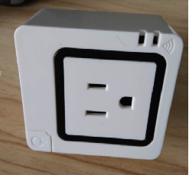
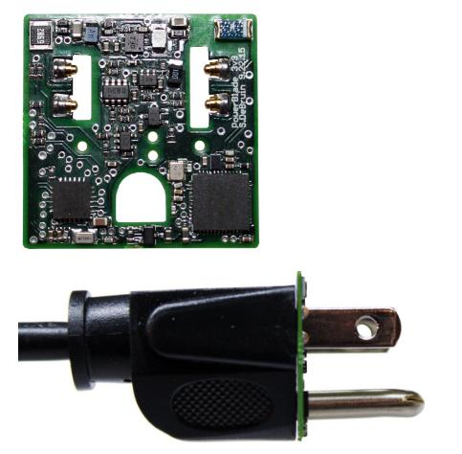
PowerBlade: A Low Profile True Power Plug Through Energy Meter
Samuel DeBruin,
Branden Ghena,
Ye-Sheng Kuo,
Prabal Dutta.
https://lab11.eecs.umich.edu/projects/powerblade/
SenSys 15’
Notes:
第一作者，现在是博士二年级

Slide 2

Why to select this one from miscellaneous papers?
1. Originated from real project
smart safety plug of scu
2. Luxapose(visible light localization) related
Prabal Dutta, eecs.berkeley.edu
4. Popularity
25 cites by other papers
3. Contribution and values
an Edge device for classifical IoT application
compared with HelloEdge about similarity and difference
5. Innovation finding
IPv6 on BLE research testbed
AI(neural network) migration into edge device
Notes:
为什么从众多文章中选择这篇文章？
1 来自实际项目，有github代码资料公开的，来自顶级研究机构的
2 luxapose光定位文章团队做的一篇文章
3 谷歌上的25个引用
4 一个典型的物联网应用
5 发现创新，IPv6和WSN，NN前移到边缘设备
技术共性问题和差异化问题

Slide 3
Abstract
PowerBlade,
smallest, lowest cost and lowest power AC plug-load meter
measures real, reactive and apparent power
calculates cumulative energy consumption
reports over BLE
Requires revisiting every aspect of conventional power meters,
a new method of acquiring voltage
a non-invasive planar method of current measurement
an efficient and accurate method of computing power
a radio interface that leverages nearby phones and send to edge
a retro power supply reimagines vastly lower current, miniaturization
Parameters,
1in*1in footprint, 1/16in profile, <180mW(60mA 3.3v), 1.13% error, $11
Notes:
PowerBlade有五个方面电压/电流/功率/
重新审视传统电力仪表
一种新的获取电压的方法，一种非侵入的电流测量方法，一种有效和精确的计算功率方法，一种无线接口用于讲数据传送到边缘侧，一种复古式的电源
英寸1in=2.54cm长度
2.54cm*2.54cm
6cm*8cm。尺寸是他的4-6倍。

Slide 4
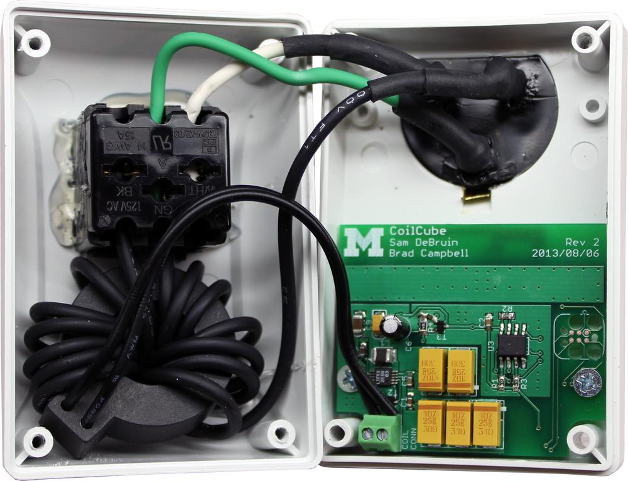
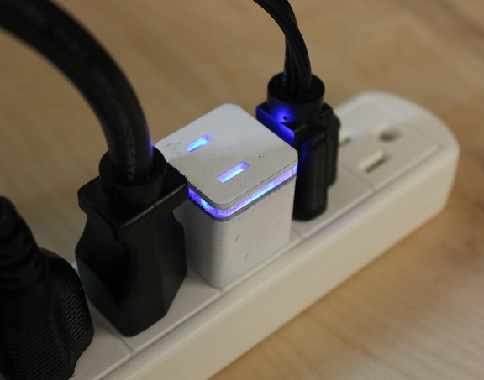
History
Keywords,
AC meter,
Smart meter,
Energy metering,
Power metering,
Plug-load metering,
Data aggregation,
Intermittent power,
Wireless sensor Network
Project, http://github.com/lab11/powerblade
Created at Nov 20, 2014, Last commits on Jul 28, 2018
2199 commits
Based on Monjolo and PowerCube, created PowerBlade
paper output,
Monjolo(SenSys'13)
Deltaflow(e-Energy'14)
EnergyHavest.(ENSsys'14)
Notes:
关键词，交流表，智能表，能量表，功率表，插塞载荷，数据汇聚，间隙式功率表，无线传感网
项目在github上有，2014-2018时间跨度在进行迭代

Slide 5
I. Introduction
II. Related Work
III. Design
CONTENTS
IV. Implementation
V. Evaluation
VI. Discussion
VII. Conclusion

Slide 6
I. Introduction
Residential and commercial buildings used 2,760 TWh of electrical energy，
HVAC, lighting, appliances
20% of plug-loads
understanding every load is important
lack tools to monitor energy with high fidelity and low cost
Address this problem，
PowerBlade
Different from other，
PowerBlade metering every load
6mW itself
Notes:
商业和居民建筑电能消耗惊人，骨干电网的监控做得比较好了。我们能不能在约束条件上下功夫。
电力系统末梢，每一个用电设备（也是一个典型的物联网设备）的状况了解是非常重要的，但是现在确实需要一个方式和工具来对每个负载进行高保真的监控，并且还要低价，同时尺寸又要小。
PowerBlade就是为了解决这个问题。跟其他系统最大的不同就是，PowerBlade监控每一个负载，而本身只有6mW。
传统电流感知需要将电阻放在电流回路中，比如电流互感器，霍尔传感器，测量磁场
阻性负载，1.13%的平均错误。其他类型的，6.5%误差；
改进，电流和电压的同步采样，功率因数计算，保护计量数据，时间戳，时间间隔
增加理解插座负载使用模式的能力
大规模和长期的部署可能插座负载的使用和趋势有更清楚的理解。特别是因为待机模式造成的能量损失，提供能量标准的管理者关键数据。

Slide 7
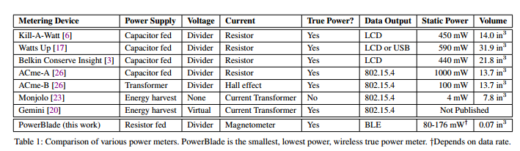
II. RELATED WORK
A trure-power meter performs five distinct functions，
reduces AC voltage to DC voltages to power meter itself
measures voltage
measures current
calculates power and energy
comminucates these measurements
Scaling a power meter to PowerBlade's form factor requires
revisiting each of these functions
Notes:
真正的电力仪表应该包括Powr Supply，Voltage检测，Current检测，数据输出，静态电流，体积几个层面。
商业和研究计量表，
三个商业表，Kill-A-Watt，Watts Up, Belkin Conserve Insight
三个研究表，ACme， Monjolo, Gemini, PowerBlade

Slide 8
II. RELATED WORK
AC-DC Power Supply
rectify and step down the AC voltage
energy harvesters often require bulky transformer unsuited
capacitor-fed power supplies, a high voltage series capacitor drops the line voltage and limit current, which donot provide isolation
To source 10-100maA, the capacitor must be high-valued(1-2uF)
eschews energy harvester and transformers, due to scaling challenges
embraces a capacitor-fed, Zener-regulated power supply.
Notes:
任何一个表，要从交流表中取电，就得对AC电压进行整流和降压到DC。
交流适配器需要变压器
capacitor-fed的电压，电压是下去了，但是电流比较小。《1998 A capacitor-fed voltage step down single phase non isolator rectifier》
回避了Energy Harvest和变压器，capacitor
zener二极管，就是稳压二极管，利用pn结反向击穿状态，其电流可在很大范围内变化而电压基本不变，起稳压作用
半波和全波整流器，考虑这里将半波和全波整流电路拿出来。

Slide 9
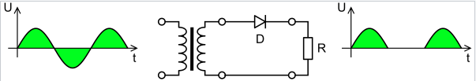
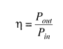
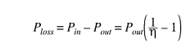
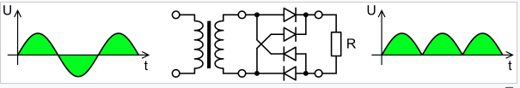
II. RELATED WORK
Half-wave rectifier
Full-wave rectifier
Full-wave rectifier with parallel RC shunt filer
Notes:
半波整流，全波整流电路，具有RC分流滤波的全波整流电路

Slide 10
II. RELATED WORK
Voltage Measurement
time-synchronized voltage and current measurements
multiply them together to obtain power.
a voltage divider to obtain a scaled-down version of the voltage signal
taking distributed measurements requires at least two different devices which increases cost and makes deploy cumbersome, while only using the current channel leads to errors for non-unity power factors
borrows an idea from the FlipIt plug-through USB charger for its voltage acquisition
Notes:
电压测量，
时间同步电压和电流测量；
相乘得到功率；
电压分压器；
分布式测量需要两个不同的设备，可能会增加成本和部署成本。仅仅增加成本，使设备部署笨重，导致非同的功率因数的错误；
从电压采样的USB充电器获取到思想；

Slide 11
II. RELATED WORK
Current Measurement
rectify the most common methods for measuring current employ
a sense resistor placed in series with the electrical path
a Hall effect sensor placed co-planar to a current carrying conductor trace
a current transformer (CT) that encircles the current carrying conductor
a current sense resistors are inexpensive, accurate and small but requires the electrical path to be broken and an AC
use an optimally-placed surface mount inductor to measure the variation in magnetic flux produced by a current carrying conductor
the inductor coil(or inductor sensor) whose terminal voltage is proportional to the rate of change of the current over time
requires signal integration to recover the original current signal
difficult using conventional current sensing methods
Notes:
1.测量电流；
串在电气路径中的感应电阻；
霍尔效应传感器，电感路径在一个平面；
电流互感器；
电流感应电阻虽然不贵，准确和尺寸也小，但是需要切开交流电路径；
2. 使用一个优化的表面贴片电感来测量；
电感线圈，两端的电压与电流的变化成正比；
需要信号集成来恢复原始的电流信号；
使用传统的电流方法是不同；

Slide 12
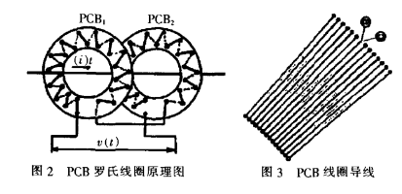
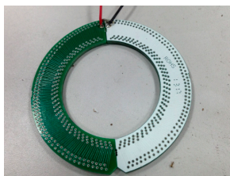
II. RELATED WORK
Current Sensing --rogowski coil
2016 Sensors
<A novel transient fault current sensor based on the pcb rogowski coil for overhead transmission lines>
one of hot research points about power current sensor
Notes:
罗式线圈

Slide 13
II. RELATED WORK
Power Calculation
There exists three common options for calculating power.
The first is to use power metering IC like the analog devices ADE7753
A second option employed by several meters in our survey is to calculate power from the acquired current and voltage in software running on an embedded microcontroller.
the monjolo design does not report trure power
Data communication
LCD Display
another communications option is wired, like USB or Ethernet
wireless radios, 802.15.4, multi-hop mesh network
none of these meters allow users to connect directly using a smartphone
will soon support IP connectivity and end-to-end networking
Notes:
之前的功率计算，存在三个通用的方法，1.采用专用新品ADE7753. 2. 直接计算；3. 不用报告这个功率数据；
数据通信，LCD显示，可以采用有线的USB或以太网，无线802.15.4. 多跳mesh网络；用智能手机的还不多。后续很快支持ip设备连接。

Slide 14
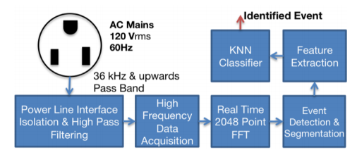
II. RELATED WORK
Alternate Power metering methods
Fine-grained power data does not require individual load metering.
ElectriSense determine device state simply by monitoring AC voltage at a single point and measuring the EMI generated by switched mode power supplies and propagated by the wiring throughout the building
How often it reveals the resident's current activity(e.g., stove usage implies cooking)
Notes:
其他的电力计量方法
1. 细颗粒度的电力数据不需要每个负载计量
2. ElectriSense能判断是状态，通过交流电压，在单点，测量EMI，由开关电源产生，通过电力线在建筑内传递的
3. 用于室内的电力时间识别和分类单点传感；电炉使用暗示了做饭；
4. 识别一些switched mode power supplies。
5. 通过长达6个月，7个房间的识别，能够对SMPS电气时间进行识别和分类。
6. 采用一种有监督的学习算法KNN

Slide 15
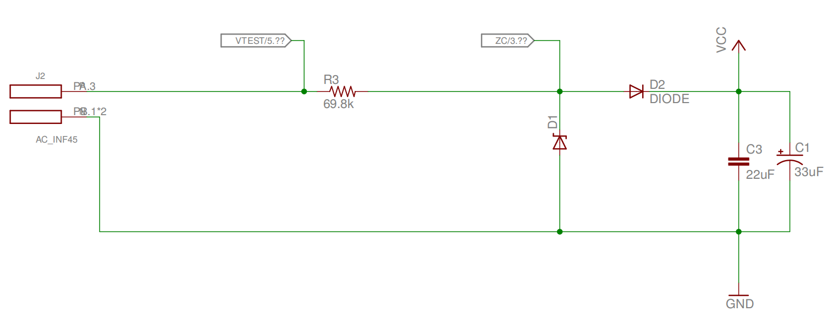
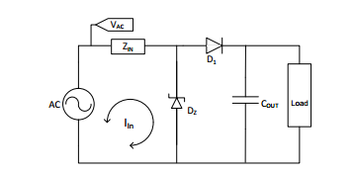
III. DESIGN
PowerBlade performs the same five functions other power meters, but in a planar, plug-through form factor
Power Supply
PowerBlade optimizes for size by using a power supply design that does not require an IC.
a Zener regulated, half-wave rectified power supply.
1.25mm spark gap
not isolated, Safety , its ground is tied directly to the neutral line, which could be a possible safety issue when interacting with the circuit.
limit inrush current is a capacitor, in series with a resistor.
Notes:
1这个图是参考
http://ww1.microchip.com/downloads/en/appnotes/00954a.pdf
这篇文章讲述的非常好，将各种负载场景都考虑到了。这是无需变压器的比较好的解决方案
2半波全波整流；器件和体积都比较小。Zin的选择影响到最后系统的功率，总的体积，idle电流。
3 安全问题，零线接到地上。地线有可能是220v交流，只要用户不要接触到地线，供电来说没有问题。但是这个是无线系统，对最终用户不会有太大的影响。
4. 采用Microchip的SR086 SR087 可调离线无电感开关型电压调节器，体积很大；
5. 采用LNK302的方案；

Slide 16
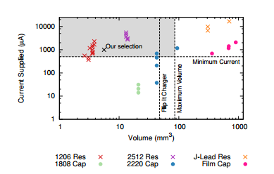
III. DESIGN
Fig shows the design space for Zin based on component volume and supplied current.
A third parameter, not pictured, is idle power
Tradeoffs for this simple supply, the volume occupied by the supply
current is not free even though the system is attached to AC.
more current larger package
The pareto-optimal point for current is 10kΩ 2512 resistor that can supply 5.5mA and requires 13.1mm²
Notes:
1. 大电流大体积；
2. 参数的小变化可能带来体积上的量的变化；
3. zin低阻值，大电流，需要更大尺寸来耗散功耗。
4. 电容性负责的话，不会增加idle电流的，高电容电阻抗可以提供搞多电流但是要求更大的尺寸。
5. 1210电阻
6. pareto-optimal点在哪里

Slide 17
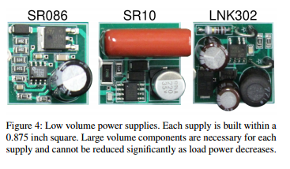
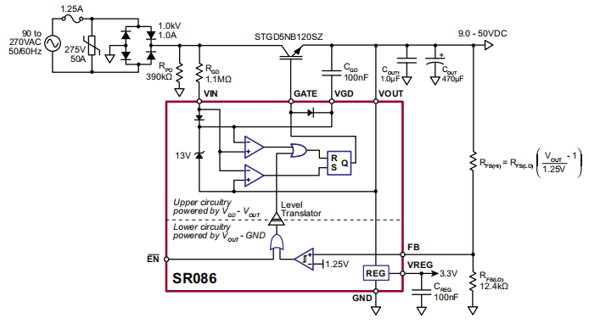
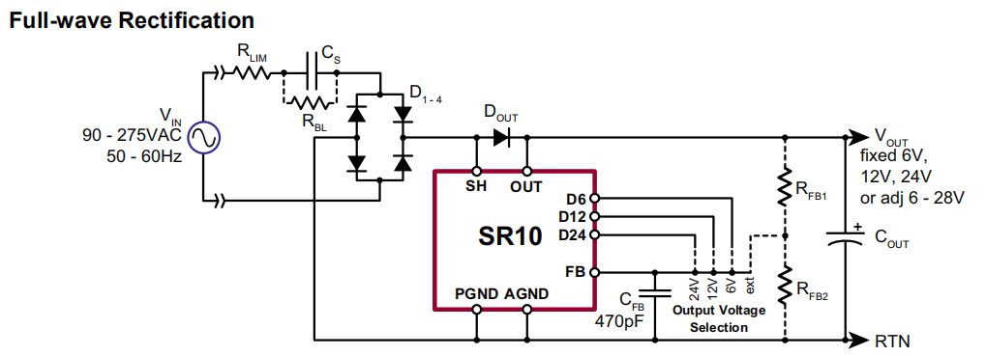
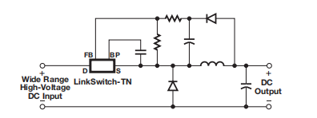
III. DESIGN
Providing significantly higher current but requiring greater volume.
The range of acceptable volumes is determined experimentally on several NEMA outlets.
Notes:
这些方法都不能很好地随着负载功率减少而减少体积。
1. SR86芯片的外围电容比较大；
2. 提供高的电流但是需要更大体积；
3. 可接收的体积范围是由多个NEMA插座来决定的，
4. NEMA美国电气制造商协会

Slide 18
III. DESIGN
Voltage Sensing
voltage sensing in this form factor requires a planar contact method,
a voltage divider, and an ADC to acquire the voltage signal digitally
A flexible tab built into the PCB bends to provide contact as the AC plug is inserted)
The benefit is easy manufacturing
Another option is to mount a spring loaded pin sideways in the plane of the PCB.
tradeoff between flexible pcb and spring, select one off-the-shelf component.
Notes:
电压传感器，要求平面接触方法；
分压器，通过模数转换器获取电压信号；
两种可能的接触方法，小弹簧和柔性PCB；
选择一个现成的部件用于做接触；
怎么样稳定的使用是设计的关键；

Slide 19
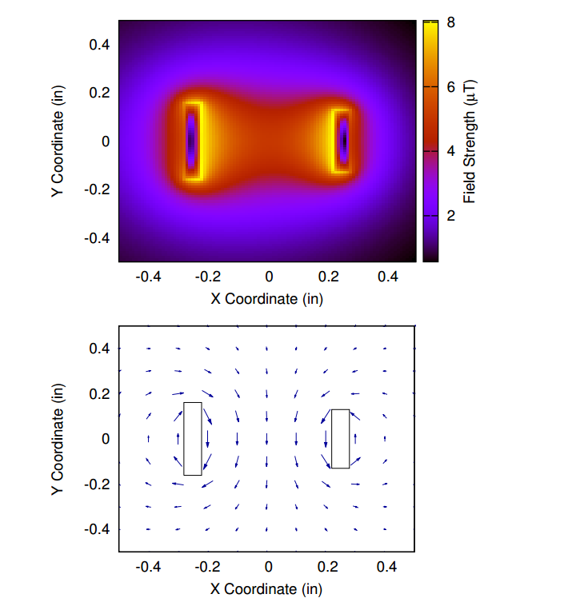
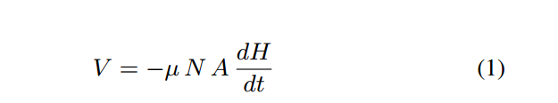
III. DESIGN
Current Sensing
Many existing sensing techniques, like shunt resistors are planar, but rely on interrupting an AC conductor, which PowerBlade cannot do.
Instead, PowerBlade senses current non-instrusively by detecting the magnetic field surrounding an alternating current.
Magnetic field
optimal placement of a sensor to measure this field.
First, the magnitude of the field is on the order of 10-100nT, which establishes bounds on the required transducer sensitivity.
Second, rapid decrease in field strength with distance from the conductor means the strongest signal is closest a prong.
Hall effect
Notes:
1. shunt resistor分流电阻；可能需要破坏交流的导线，这个项目是不能这么做的。
2. Biot-Savart law 毕奥萨伐尔定律 relative strength and orientation of this magnetic field
3. 两个方面，磁场强度10-100T,建立互感器的自感边界；
4. 离导线的距离快速强度降低，意味着离prong最近的地方信号强度最强。
5. 霍尔传感器其他基于向量的磁力计，能够感知磁场，但是尺寸是比较小的；
6. 很多此类设备不能满足系统设计的需求，意味低感知能力，低采样率；
7. 采用coil磁力计；
8. 模型允许大家优化位置和线性电感，最大化感应电压。
9. Faraday 电磁感应定律, u magnetic permeability, N 线圈的个数，A线圈的截面积，电压跟磁场强度成正比。而不是电流。
10. 信号应该集成来恢复原始的电流模型。

Slide 20
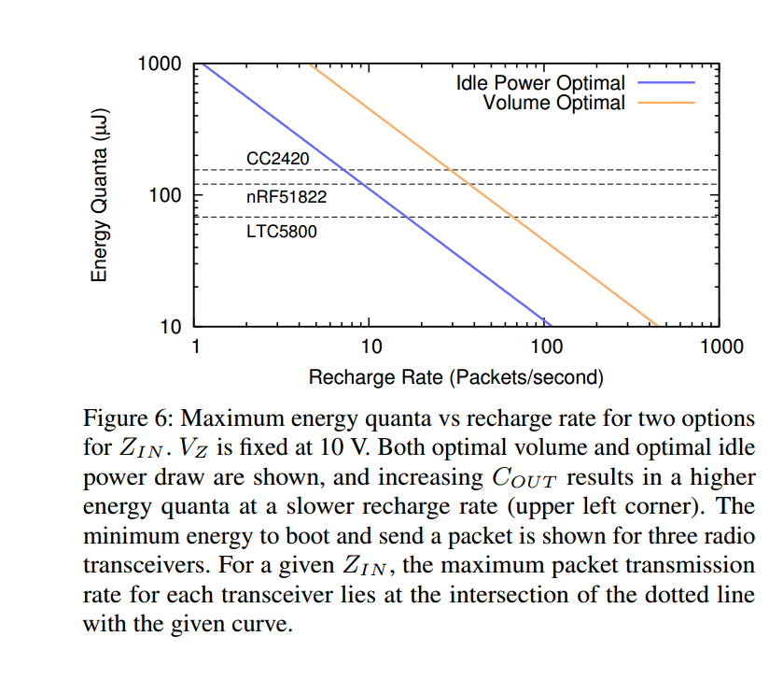
III. DESIGN
Power calculation
the form factor or power requirement prevent the use of a dedicated metering chip
as is the case for PowerBlade, then the only remaining option is to implement custom measurement software in a low power microcontroller.
balance the fidelity of measurements with availability of power.
higher sampling rate will improve measurement accuracy, but it will also draw more power due to increased data conversion rate and more frequent processor wakeups.
the measurements themselves must be scaled from raw ADC counts to power statistics through various transfer functions that may require floating point arithmetic.
Notes:
1 尺寸要求和功率要求是的专用的计量芯片将没法使用；
2 这个case下面，唯一的选项是自己实现测量软件；
3 平衡测量的保真性和电能，高的采样率可以提高测量精度，但是会消耗更多的功率，增加数据转换率和更多的处理器唤醒时间；
4 各种转换函数和方程，需要浮点型计算。
5. CC2420是TI的芯片，nRF51822是nordic的芯片， LTC5800
6. 对比其中电能消耗；

Slide 21
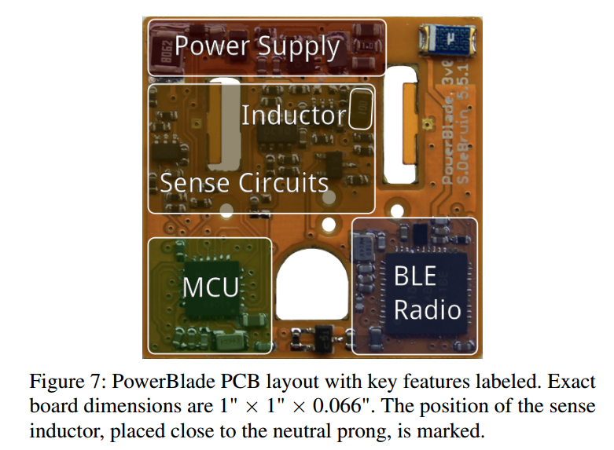
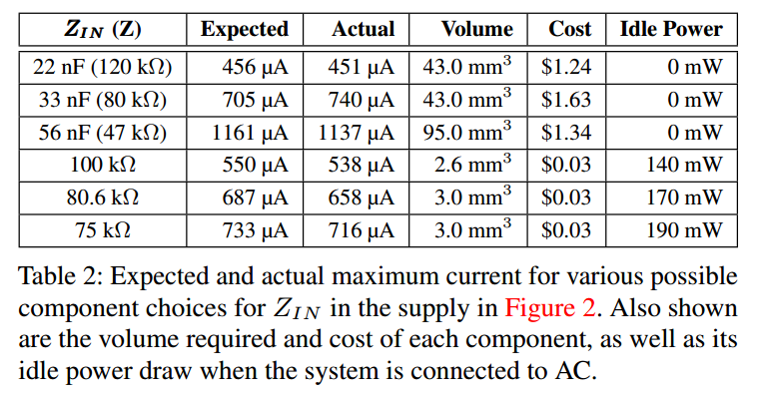
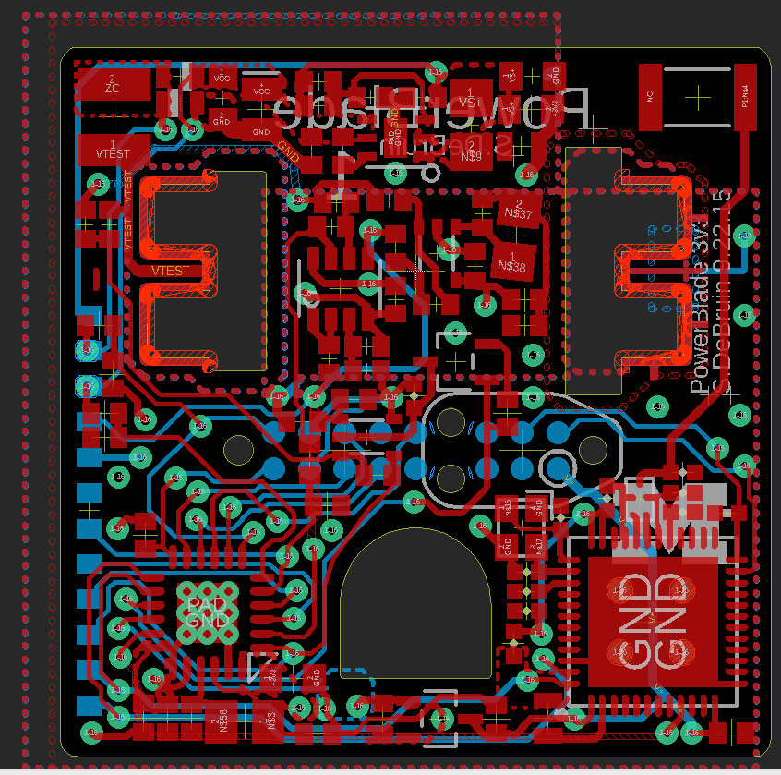
III. DESIGN
Data Communication
require a continuous burst of power.
For a wireless radio, this is the energy required to send a single packet,
How much energy is available is determined by three components from Zin, Vz and Cout
Increasing Cout will increasing the energy available, but at the expense of a slower recharge rate.
Also shown is the minimum energy required to boot and send a packet for three possible radios.
Notes:
1. 数据通信需要连续的功耗；
2. 对于无线通信来说，这个能量需要用来发送一个数据包；
3. 多少能量可以由zin, vz cout来决定；
4. 增加Cout可以增加能量，低速充电速率，减少Zin导致大的电流，增加充电率和能量。
5. 增加Vz可以增加能量和充电时间；
6. 更高的Vz值，由其他元器件限制；
7. Cout被限制到16V，很多商业的buck转换器明显可以提供更高的效率；
. 图6显示充电率和能量量子

Slide 22
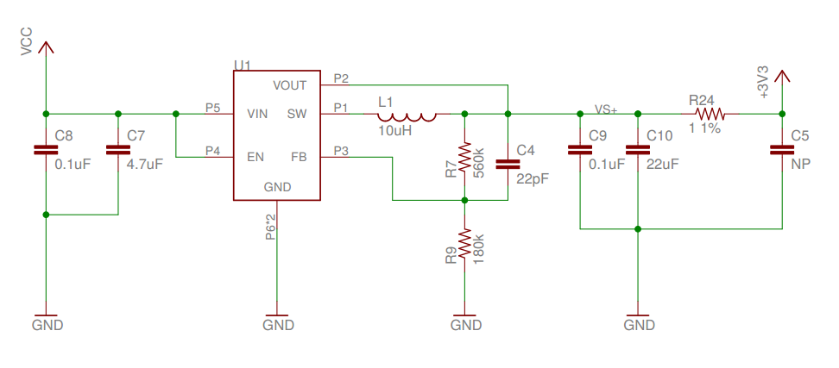
IV. IMPLEMENTATION
This section describes how the components identified in Section 3 are integrated into a system in PowerBlade. This section also covers the steps required to operate the system as a true power meter, including how the wireless system is used and how the meter is calibrated.
Early version of PowerBlade ,2220 package capacitor and 1210 package resistor
To regulate this output to 3.3v we use a 3.3v buck regulator, TPS62122
(TPS62177 in smart lock), efficiency of 85-90%.
Notes:
1. 描述在前一节的器件被集成到系统PowerBlade中。
2. 作为真正的电力仪表的步骤，包括怎么使用无线系统的，仪表怎么矫正的
3. 早期版本，只有2220和1210封装的
4. 0.12美元每度电，170mW的成本比33nF电容成本高（80kΩ），186mW
5. 当前的选择反应了频率数据传输，也注意到Zin的值更高，可能数据传输率也会相应减少
6. 10V 齐纳二极管和250mA整流二极管，SC-79封装。55uF

Slide 23
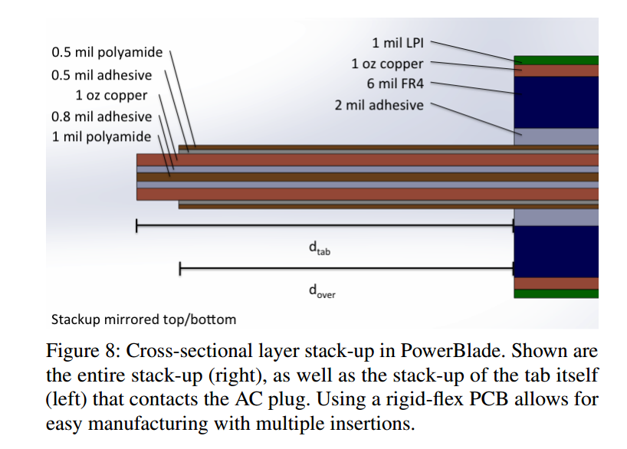
IV. IMPLEMENTATION
Contact
This method of circuit board construction maintains good contact for 10-30 insertions, providing a pathway to a proof of concept, but we intend to continue to explore methods using spring loaded pins in future work.
Notes:
接触，这个电路板的构建方法

Slide 24
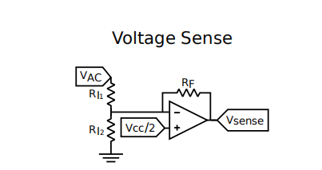
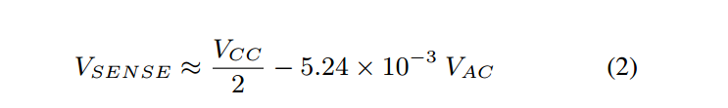
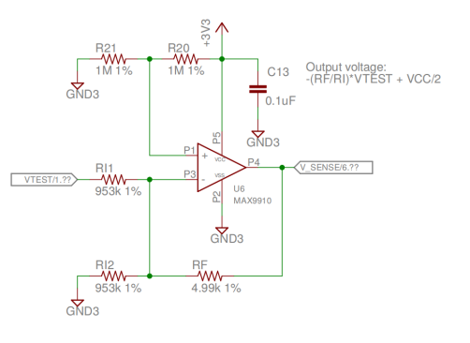
IV. IMPLEMENTATION
Measurement Amplifiers
shows the amlifier circuits used to measure voltage and current.
PowerBlade measures line voltage directly through a voltage divider with a Vcc/2 offset to measure both positive and negative phases. Rf=4.99kΩ Ri1=Ri2=953kΩ
Based on configurations, the voltage signal has a peak to peak amplitude of 1.79V where the AC is 120Vrms
Notes:
1. 电路的叠加原理，
2. 运算放大器的虚地虚短等效作用

Slide 25
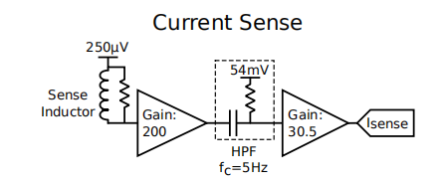
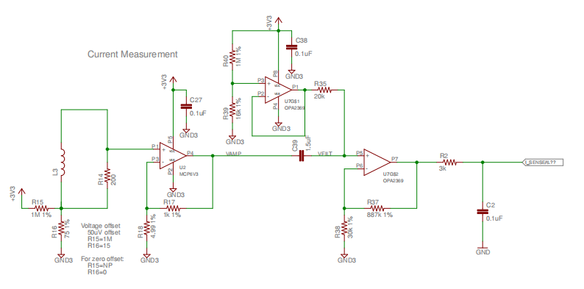
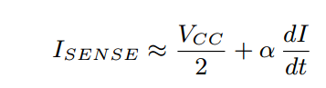
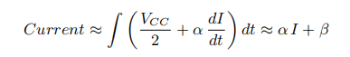
IV. IMPLEMENTATION
PowerBlade measure the signal from the sense inductor in multiple stages.
The inductor is referenced to 250uV and amplfied in two stages with a combined gain of about 6100x
Low frequecny noise is removed with a high pass filter between the first and second stages, and this filter is referenced to 54mV so the final signal is centered around Vcc/2.
Notes:
1. 分为两级来；
2. 中间有一个高通滤波器；
3. 电流有两个，后面这个是积分；

Slide 26
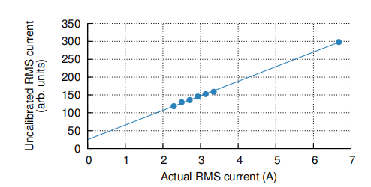
IV. IMPLEMENTATION
Calibrating PowerBlade
require two steps
first step is to measure the scaling and offset values α and β
second step is a device-specific calibration that accounts for slight variations between units
α and β, we measure the reported RMS current from PowerBlade for a range of resistive loads
α ，40.85， β， 25.0 linear with 0.999*R²
To reduce the computational burden on PowerBlade, we divide by α in the receiver, and for increased accuracy, each unit is calibrated again
after calibrating α， we notice an exponential error not accounted for by the model.
Notes:
校准，有两步，第一步， α and β，第二步，设备相关的校准；
斜率α =40，截距β=25

Slide 27
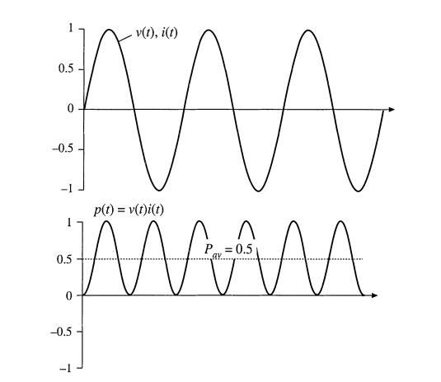
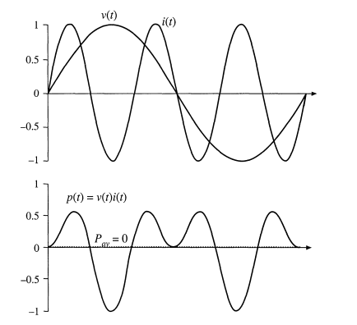
IV. IMPLEMENTATION
Power Calculation
performing power metering calculations on a MSP430FR5738
to measure power, the MSP430 samples Vsense and Isense at 2.52khz(42 samples per AC cycle), AC frequency is 60hz
real power is determinied by multiplying voltage and current at each point
apparent power is determined by first calculating the root mean square voltage and current over a cycle,
reactive power as well as the power factor of the load
real power is also aggregated in the MSP430 to compute total watt-hours measured over time, and this number is stored in FRAM.
Notes:
功率计算是在MSP430FR5738上进行的；
为什么被选择，是因为他的小尺寸，低功耗等优点；
2.52khz的采样频率，每个周期有42采样点，美国的交流点是60hz.
有功是由电压和电流的乘积来决定的；
视在功率是由每个循环或周期的均方电压和电流计算得到；
无功功率和功率因数，功率因数是指电压的向量表示/电流的向量表示之间的夹角关系，cos

Slide 28
IV. IMPLEMENTATION
BLE communication
msp430 communicate to nRF51822 via UART at 38400 baud
msp430 send uart data at 1hz
nRF51822 send advertisement at 5hz
so 4-5 identical packets are transmitted each second.
four fields of packets: line voltage, instantaneous real power, instantaneous apparent power, watt-hours
Robust against packet loss
the intended recipient of broadcast advertisements is either a smart phone or a fixed BLE receiver
Notes:
功率计算是在MSP430FR5738上进行的；
为什么被选择，是因为他的小尺寸，低功耗等优点；
2.52khz的采样频率，每个周期有42采样点，美国的交流点是60hz.
有功是由电压和电流的乘积来决定的；
视在功率是由每个循环或周期的均方电压和电流计算得到；

Slide 29
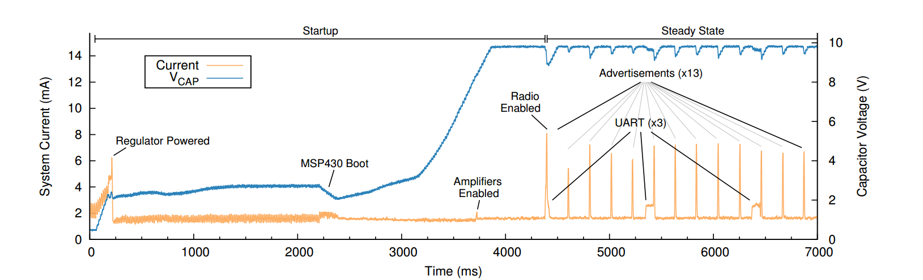
IV. IMPLEMENTATION
System Operation
show the startup phase of PowerBlade and 7s of steady-state operation
When the system first starts, there is only power to boot the MSP430
Notes:
系统的启动时序

Slide 30
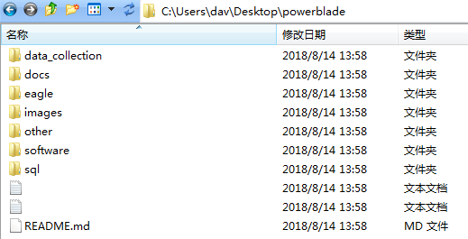
IV. IMPLEMENTATION
http://github.com/lab11/powerblade
data_collection:
docs
eagle: schematic and pcb design files
images:
other
software:firmware,
sql:

Slide 31
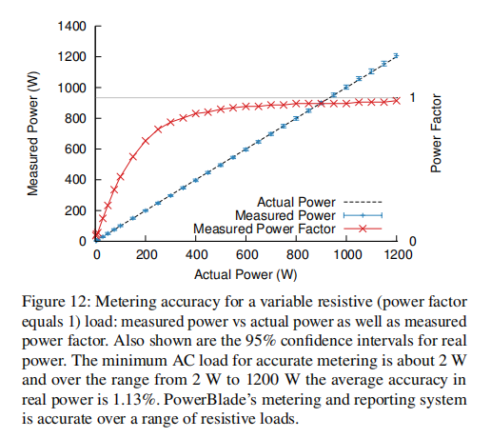
V. EVALUATION
Evaluate PowerBlade on the basis of accuracy in reporting real power for both a calibrated resistive AC load and an assortment of household loads.
present benchmarks that affect the usability of the system, including PowerBlade's volume, cost, wireless performance and safety of using the system.
Power Metering Accuracy
explore bench top accuracy,
report the Watts Up measurements over the low range as well,
resistive loads
household devices
watt-hour accuracy
Notes:
评估PowerBlade，
展现一个基准，影响系统使用性。包括PowerBlade的体积，成本，无线性能，系统的安全。
评估精度，1. 最高精度，2， 测量家电。
30 PowerBlade测量，30ground truth测量，报告算术平均值，95%信任间隔
2w-1200w范围内的测量功率，实际功率，测量的功率因数

Slide 32
V. EVALUATION
Resistive loads
resistive loads with a unity power factor, which include incandescent lights and power-factor-corrected devices, exhibit a sinusoidal current waveform in-phase with voltage.
Notes:
电阻性负载，功率因数矫正设备，电流和电压都是同相

Slide 33
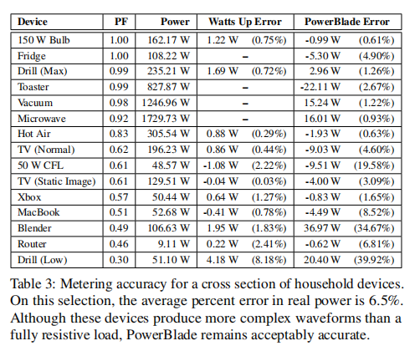
V. EVALUATION
Household devices
Notes:
电阻性负载，功率因数矫正设备，电流和电压都是同相

Slide 34
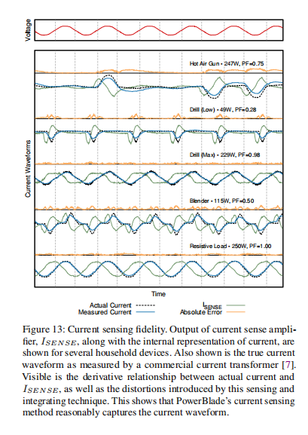
V. EVALUATION
Power Metering Accuracy
PowerBlade is designed to measure and report both instantaneous power and watt-hours, the sum over time that will be used by the utility company to levy charges
Notes:
评估PowerBlade，
展现一个基准，影响系统使用性。包括PowerBlade的体积，成本，无线性能，系统的安全。
评估精度，1. 最高精度，2， 测量家电。
30 PowerBlade测量，30ground truth测量，报告算术平均值，95%信任间隔

Slide 35
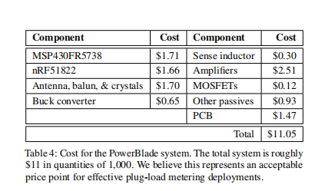
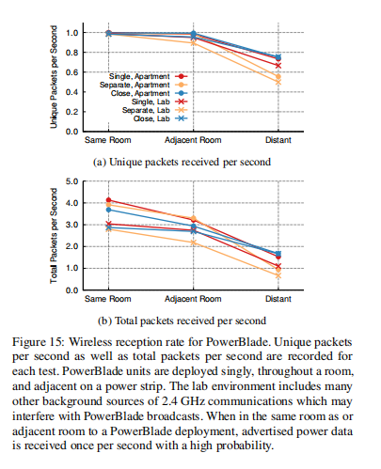
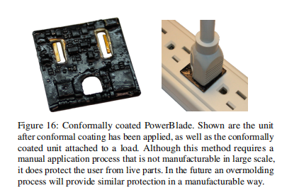
V. EVALUATION
Usability Benchmarks
PowerBlade's accuracy makes it comparable to other power metering systems
Volume
Cost
Wireless Range
Safety

Slide 36
VI. DISCUSSION
In this section, we discuss some limitations of the current design, explore some possible workarounds, and propose some future directions for improvement.
Improving accuracy
MSP430 mcu software algorithm obtain the current waveform.
a hardware implementation may better address baseline drift.
acquisition of the current and voltage waveforms could be more tightly synchronized.
22.2us delay between current and voltage sampling
Although error in real power is only 1.13% for the resistive loads and 6.5% for household devices.
shows the accuracy in power factor decreases significantly at lower wattages
A similar effect is observed in the household loads
Real power is the metric used to assess utility charges, so we believe this to be the more important value, but we have yet to determinie the source of the error in apparent power.
Notes:
讨论一下当前设计的一些限制，探索一些可能的工作，提出一些未来的方向和改进思路。
改进精度
1. 电流波形
2. 硬件实现满足漂移；
3. 电流和电压的波形更加同步；
4. 电流和电压之间的22.2us延迟；
5. 电阻性负载有功功率有1.13%的误差，但是家庭设备有6.5%的误差；
6. 在低的功耗的时候，功率因数的精度会降低；
7. 有功是用来度量充电的，所以我们相信这个是很重要的，在视在功率上的错误还没有办法决定。

Slide 37
VI. DISCUSSION
Interval Metering
PowerBlade can store accumulated energy in non-volatile memory, allowing it to aggregate total load usage.
this data is a scalar value representing total load since boot or since inception.
PowerBlade could be much more useful if it could serve as a fine-grained interval meter, providing energy usage data broken down by periodic intervals--typically 1, 15, or 60 minutes in duration--that are synchronized in time with other meters and wall time as this allows better visibility into energy use over time.
To support interval metering, PowerBlade needs a reliable method of obtaining and keeping the time, likely a combination of a wireless time synchronization protocal and real-time clock. The primary difficulty in adding this form factor.
To that end, we have identified supercapacitor capable of storing sufficient energy to operate an RTC for extended peroids.
Notes:
1 间歇式的仪表
PowerBlade用来存储累计能量，允许汇聚总的负载使用情况；
这个数据代表了总的负载；
PowerBlade4可以作为有效的间隙式仪表，提供能量；
和其他仪表一起可以对能量有一个很好的可视化效果；
2. 超级电容的使用等

Slide 38
VII. Conclusion
The state-of-the-art in plug-load metering fails to provide consumers and corporations the detailed knowledge they need to understand and adjust their energy consumption patterns at a size, cost, power, and usability point that permits widespread adoption.
Existing system for measuring them remain too expensive, draw too much idle power, lack a wireless interface, and are often too large or too cumbersome to easily deploy.
PowerBlade meters the power of a load in real-time and wirelessly transmits data to phone/gateway/edge
In this paper introduce several new methods, voltage sensing, current sensing, and power supply miniaturization
With this new design, gain new insight into electricity usage patterns, hopefully yielding smarter and more energy-efficient choices.
Notes:
商业公司不能提供详细的技术资料和知识；
现成系统太昂贵了，功耗也比较高，没有无线连接，太大而不容易部署
PowerBlade实时检测数据，无线传输到边缘服务器上；
对这些部分带来了新的思考，希望能产生很好的应用。

Slide 39
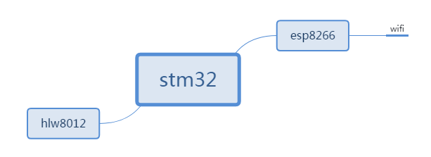
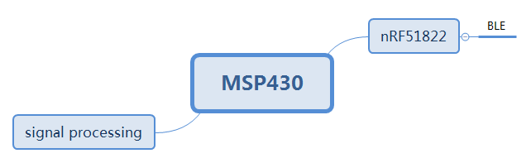
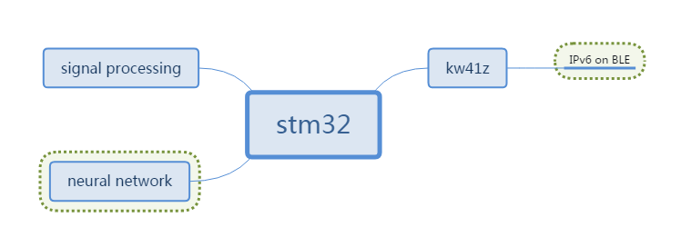
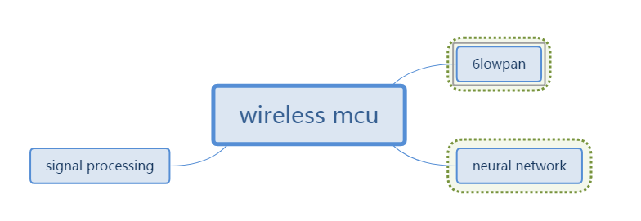
VII. Conclusion
Question
Notes:
6Lowpan作为wsn和Ipv6技术结合的产物，继承了IPv6巨大地址空间的优势，又满足无线传感网络低功耗的需求。
信号处理，是声光电？共性问题和差异问题，到底是在边缘设备做语音关键词识别，电信号分析还是光学传感信号。

Slide 40
2018
THANK YOU

